Slide 1

Deep learning project
Sfax University
National Engineering School of Sfax
Classification of Road Traffic Images
Realized by
Siwar Gouirah

Slide 2

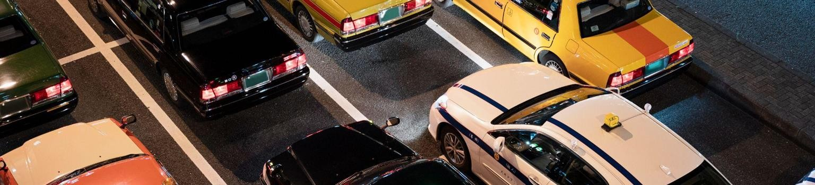
TABLE OF CONTENTS
01
Introduction
03
Realization
02
General Presentation
04
Conclusion

Slide 3

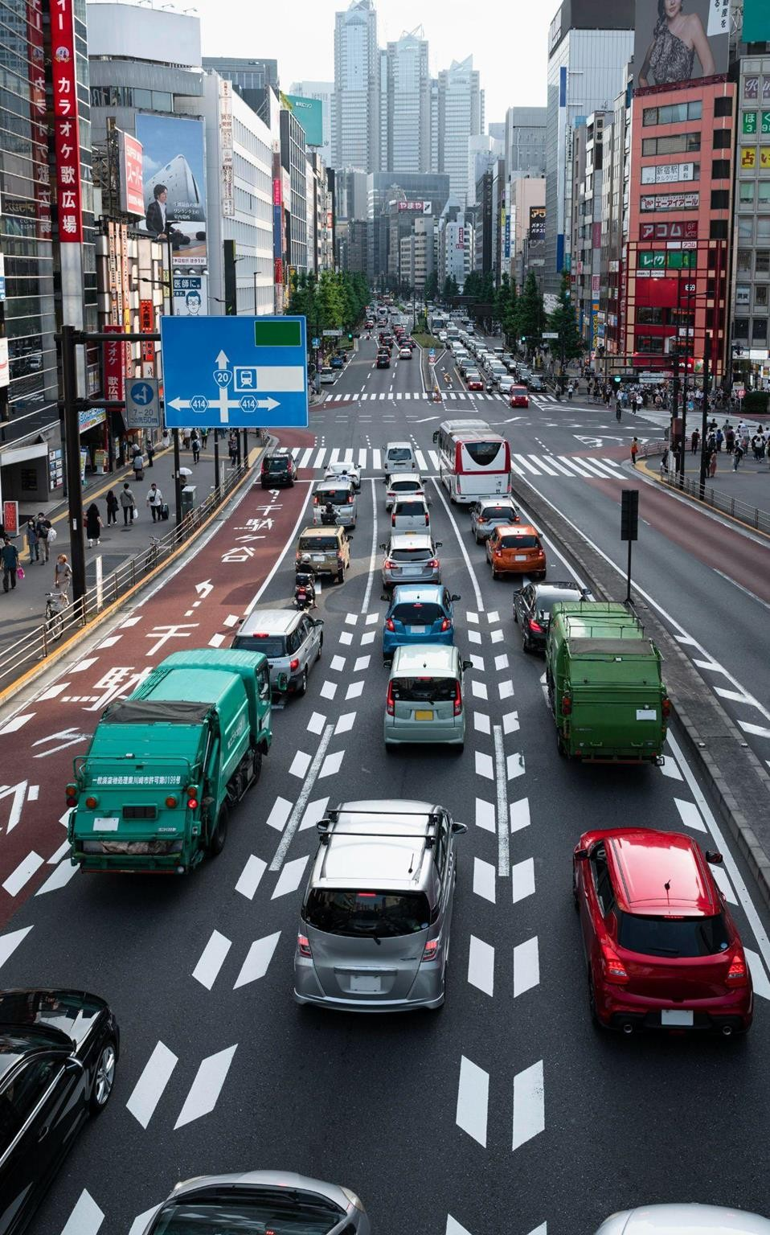
Introduction
01

Slide 4


Slide 5



Problematic
Traffic jams are a common occurrence in Tunisia.
In Tunisia, there have been 1331 accidents on the roads .
Roadworks, accidents, and unpredictable weather conditions contribute to traffic jams.
The lack of real-time information on traffic conditions hampers efficient route planning.
The need for an innovative solution to predict and anticipate traffic jams, aiming to optimize travel and enhance drivers' experience .

Slide 6



Proposed solution
Our innovative application provides real-time traffic insights
for both authorities and drivers.
The app uses advanced deep learning to predict congestion and identify vehicles accurately.
Our solution categorizes vehicles effectively, improving traffic flow monitoring by authorities.
Deep learning continuously adapts to traffic changes,
ensuring reliable predictions.

Slide 7


02
General Presentation

Slide 8
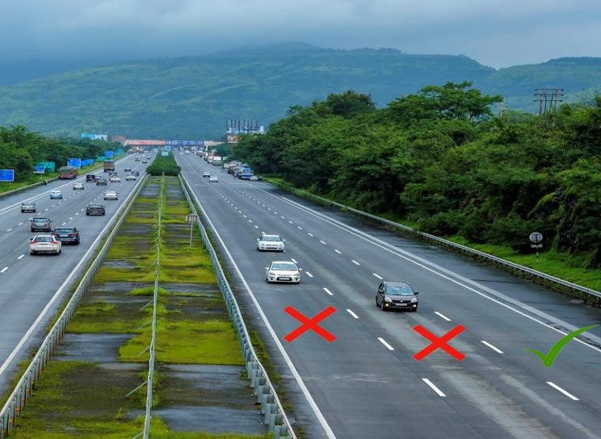
Objectives
Our objective is to address the pressing issue of road accidents in Tunisia
we aim to enhance driver security and reduce occurrences through the utilization of
Deep Learning models.
Image très grande

Slide 9

Project methodology: CRISP-DM

Slide 10
Convolutional Neural Networks (CNN):
Highly effective image classification.
Extract relevant features.
Drawbacks(image)
Sensitive to data quality.
Computationally intensive.
Eliminez les . À la fin

Slide 11
Recurrent Neural Networks (RNN):
Useful for sequential image classification.
Capture dependencies. Drawbacks:
Gradient vanishing/exploding.
Sensitive to image order.

Slide 12
Deep Neural Network(DNN):
Powerful for complex pattern recognition.
Learn hierarchical representations. Drawbacks:
Require large amounts of training data.
Computationally demanding.
Limited interpretability.

Slide 13
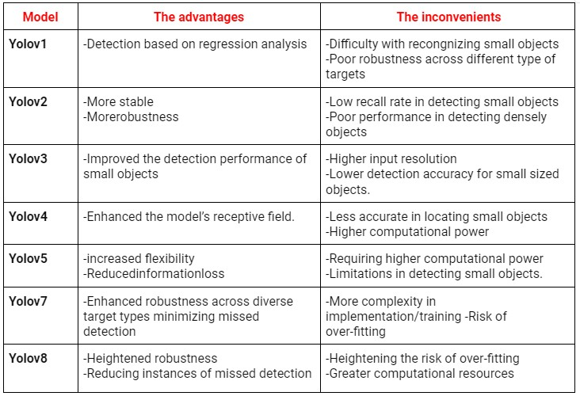
YOLO (You Only Look Once) Models:

Slide 14

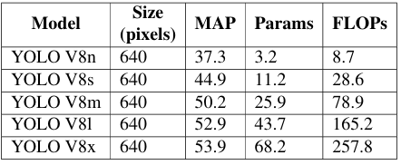
YOLOV8
YOLO V8 is an algorithm released by the Ultralytics company:
YOLOV8 is characterized by:
Accuracy
Developer Convenience
Community Support
Mettez ici l’architecture de Yolo V8
As of its release on January 10th, 2023, YOLO V8 has five versions, ranging from YOLO V8n to YOLO V8x These versions are evaluated on the COCO dataset

Slide 15
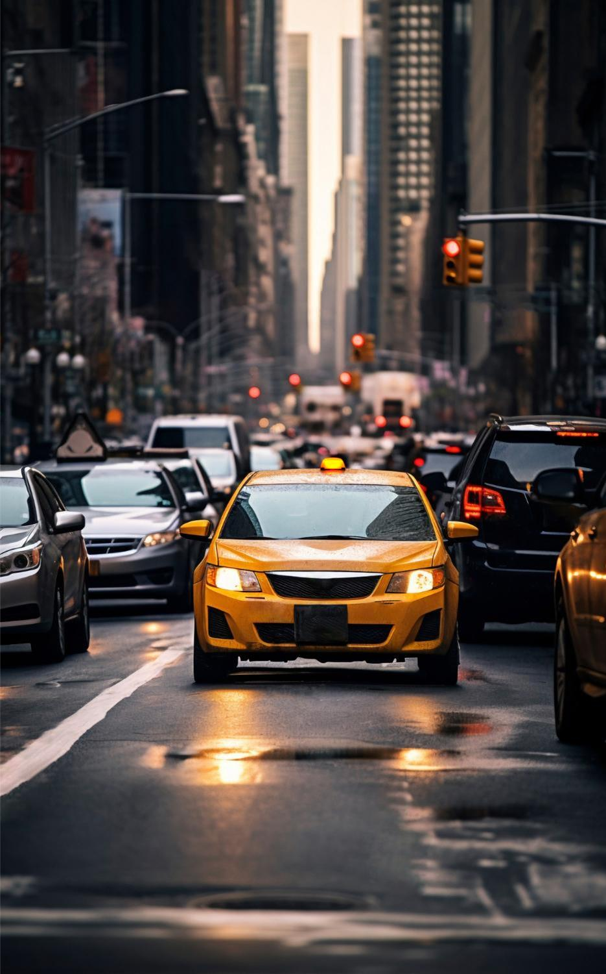
03
Realization

Slide 16
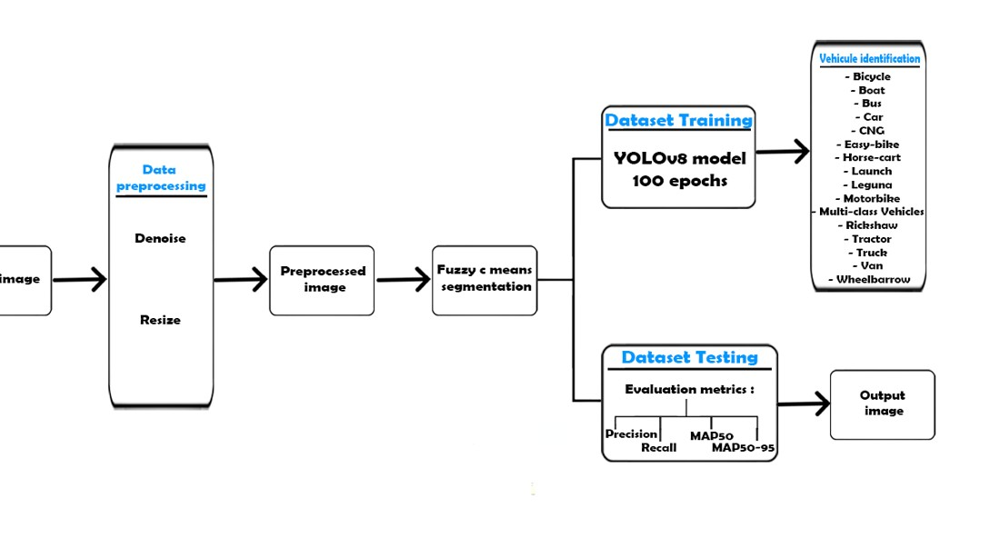
The proposed approach phases

Slide 17
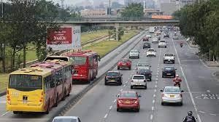
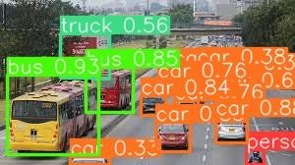
Input Image
Output image

Slide 18

Dataset Acquisition
Poribohon-BD comprises 9,058 images of 15 native vehicles found in Bangladesh.
Each image is accompanied by an annotation file specifying object positions and labels.
Annotations were performed manually and stored in XML files.
Balanced representation achieved through data augmentation techniques.
The dataset is compatible with various CNN architectures, including YOLO.

Slide 19
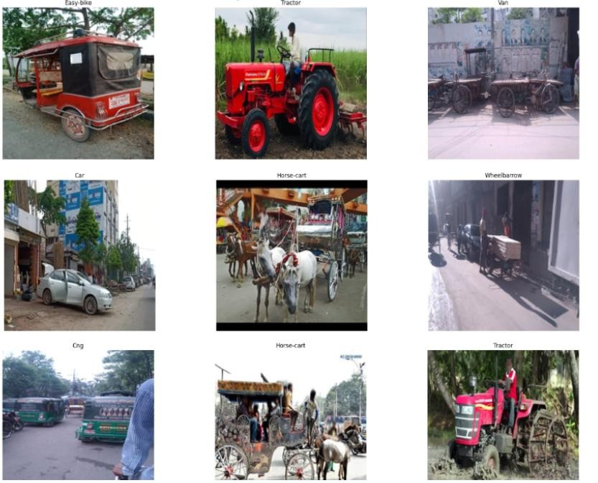

Slide 20
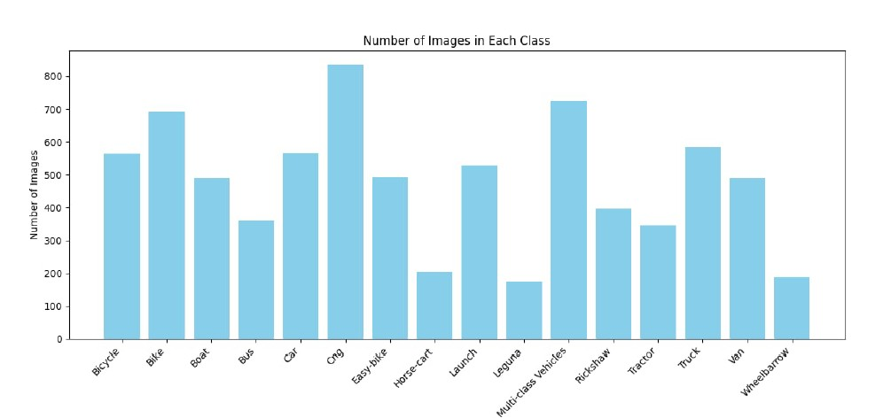
Dataset Acquisition

Slide 21
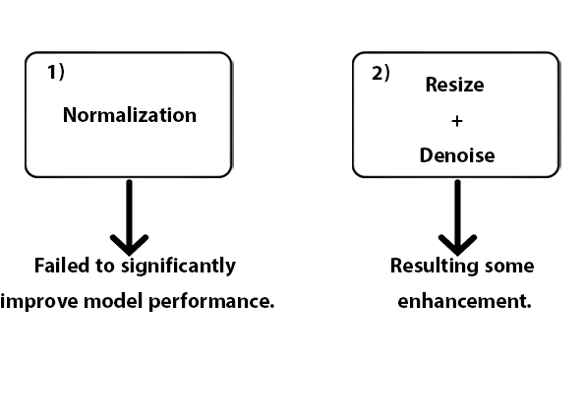
Data Preprocessing

Slide 22
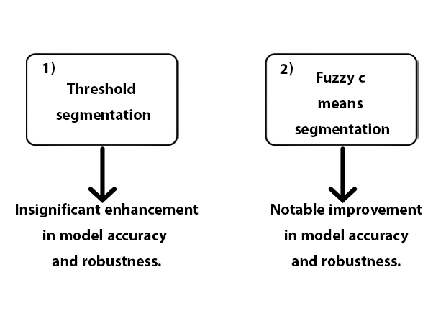
Fuzzy c-means Segmentation
Expliquer le principe de fuzzy c-
means

Slide 23
Library used in Python
os
random
pandas
matplotlib
cv2
seaborn
PIL (Image module)
ultralytics (YOLO)
numpy
time

Slide 24
Evaluation metrics
Dans quelle base
Et avec quelle technique Vous avez le tableau de comparaison entre les YOlos
Recall : 0.591
Precision : 0.753
MAP50(B) : 0.636
MAP50-95(B) : 0.406

Slide 25
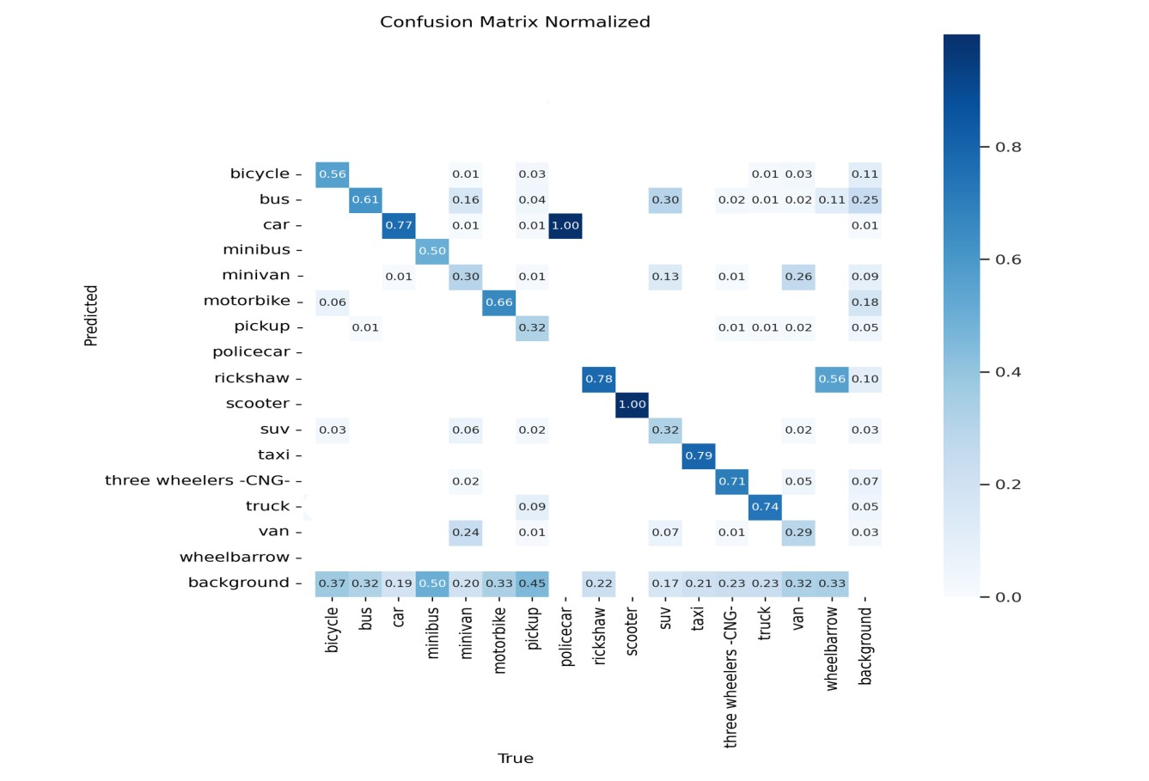
Evaluating Classification Performance without Preprocessing

Slide 26
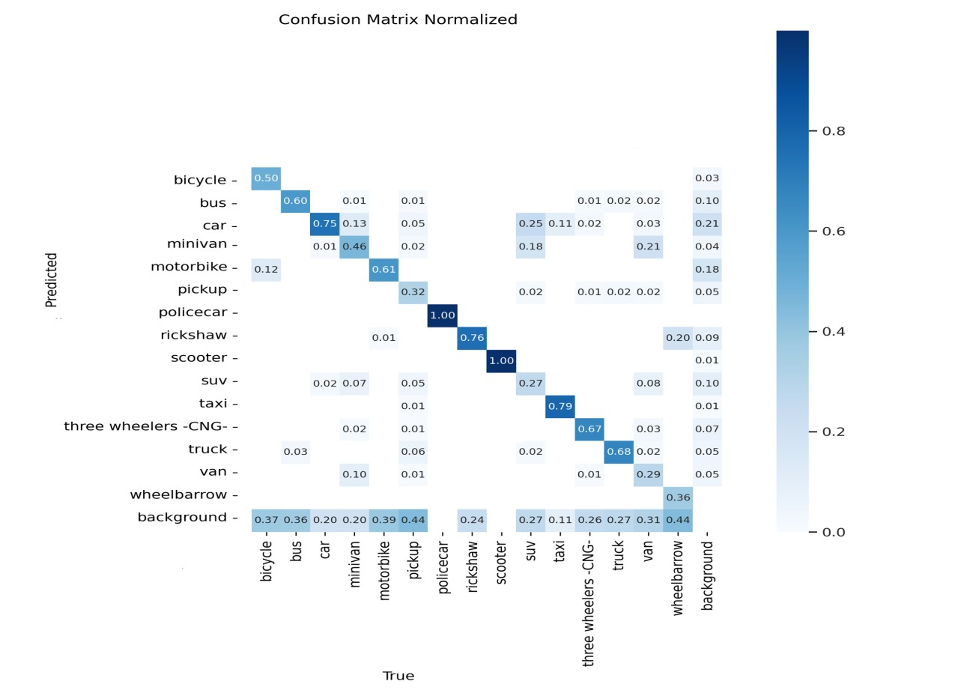
Evaluating Classification Performance with Preprocessing

Slide 27
Conclusion
04

Slide 28
Conclusion
Group work.
Staying updated on many technical
innovations.
Strengthening technical skills and achieving the majority of our objectives.
Perspectives
L’image à gauche prend beaucoup d’espace

Slide 29
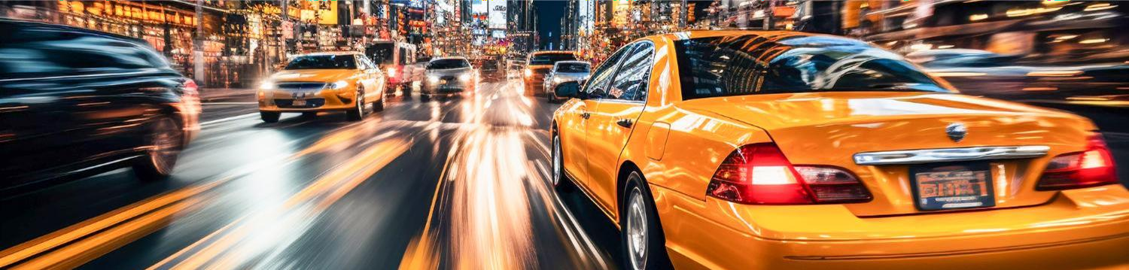
Thank you for your attention.

